Slide 1
QUANTUM HACKATHON · FINANCE TRACK
Rules that never break
Rule-preserving QAOA for portfolio decisions in Germany’s new public pension fund
Sprint presentation · Project Plan · 16 October 2026 · Decision date 31 Dec 2019
No quantum advantage is claimed. 20 options can be solved exactly in an instant.
Notes:
Opening: we did not build a bigger optimiser. We built a small, checkable decision tool and show what would change the answer. All numbers come from the canonical run (results/canonical/summary.json).

Slide 2
THE STORY WE WANT TO TELL
A pension fund that decides under changing assumptions
01 · HERO
02 · CHALLENGE
03 · GUIDE
04 · OUTCOME
The insured
Switch or keep?
Rule-safe quantum
A Decision Card
They bear every loss of the new public Kapitalrente fund.
Swap consumer goods for tech? The answer flips when assumptions move.
A QAOA circuit that can only produce valid portfolios.
Keep, switch or review: with the reason and the break-even.
Hero = who it is for · Challenge = the decision · Guide = our method · Outcome = what the committee gets
Notes:
Hero’s journey as the organisers asked. Everything else in the deck hangs off these four boxes.

Slide 3
THE PROBLEM
Swap calm sectors for technology?
Holding today
Proposal
Consumer staples (NoDur), healthcare (Hlth), utilities (Utils). One third each.
Sell NoDur, buy technology (HiTec). Tech had a great 2015–19.
Lowest swings of all 20 possible portfolios.
About +0.29 points more return per month, but more swings.
Not “find the best portfolio”
Why it is hard
Build a case that lets people decide, with clear rules, honest uncertainty and a way to see what flips it.
Only 60 months of data, a tech rally inside it, and a cost for every switch.
Source: supplied data, 2015–19; figures from the canonical run
Notes:
Set the scene: 31 December 2019. Three calm sectors, one proposal to move into tech. The point of the task is a decision a committee can defend, not a single best portfolio.

Slide 4
CLIENT
Germany’s planned public Kapitalrente fund
Planned “gesetzliche Kapitalrente”: 2 % of wages invested by a public fund modelled on KENFO. The commission asks for broad diversification, costs up to 0.1 % a year and no guarantees.
Core
Satellite tilt
Broad index. Most of the money. Not our decision.
Three of six sectors, equal weight. This is what we decide.
Who | Role
Investment committee | Decides
Portfolio managers | Use the result
The insured | Bear the losses. Each chooses a profile actively, not by age
Source: Alterssicherungskommission, June 2026 (not yet law). Mandate numbers are our assumptions.
Notes:
Client is the German government via the planned public fund. The 3-of-6 decision is a small satellite tilt; the core stays a broad index, as the commission demands. Profiles are chosen actively by each insured person, because age-based tilts would treat generations unequally. Default for people who do not choose: balanced (open assumption).

Slide 5
WHAT HAPPENED SO FAR
Two sprint days: from idea to a checked pipeline
01
Route C, Allocation: pick 3 of 6 industries as a QUBO, solved with QAOA
02
Client fixed: the public Kapitalrente fund, profiles chosen by the insured
03
Quantum vs quantum: our rule-preserving QAOA vs the organiser’s penalty QAOA
04
Switching needs proof: same winner in all 3 scenarios and ≥ 70 % bootstrap support
05
Pipeline built: one config, tests, a canonical run anyone can reproduce
Decision log with every deviation from the organiser notebook (the AI baseline): docs/decisions.md
Notes:
Data: the organiser file, checksum-verified; estimate 2015–2019, 2020–2024 only as hindsight. Fair comparison: same seeds, start points and optimiser settings for every QAOA, plus a tuned-penalty baseline so the organiser method is not a strawman. Not followed from AI suggestions: the risk route, a robo-advisor client, age-based profiles, a binding tech cap. All logged in docs/decisions.md.

Slide 6
THE DECISION
Which three sectors, for which profile?
The insured each pick one profile. We give the committee one of three answers for each.
Growth
Balanced
Risk-sensitive
Accepts big swings. A monthly loss above 8 % must be rare.
Middle way. Loss above 5 %. Also the assumed default.
Dislikes swings. Loss above 3 % must be rare.
Keep
Switch
Review: not enough evidence
“Review” is a real result, not a failure. All profile numbers are assumptions from the organiser config.
Notes:
Three profiles, three possible answers. Review means: the evidence does not settle it and the committee must state a belief. Default action in that case is to hold.

Slide 7
THE RULES
Binding rules are never for sale
Binding
Preferences
Break one and the portfolio is not allowed. No amount of return buys it back.
Weighed against each other in one score.
Higher return
Lower risk (weight 1 / 5 / 20)
Fewer changes (small switching cost)
Tech weight limit 100 % / 35 % / 20 %
Exactly 3 holdings, equal weight
Chance of a big monthly loss at most 10 %. Loss size: 8 % / 5 % / 3 %
Checked exactly, not guessed.
The tech limit is a preference, by team decision.
If everything sat in one score, enough return could “buy” a violation. Values are organiser assumptions.
Notes:
Key design choice. The cardinality rule is built into the quantum circuit; the loss tolerance is an exact check after the choice, because a probability over scenarios is not a simple formula in the variables. The HiTec limit was binding at first and was changed to a preference (penalty 0.01) by the team on 16 October; verdicts are identical without it.

Slide 8
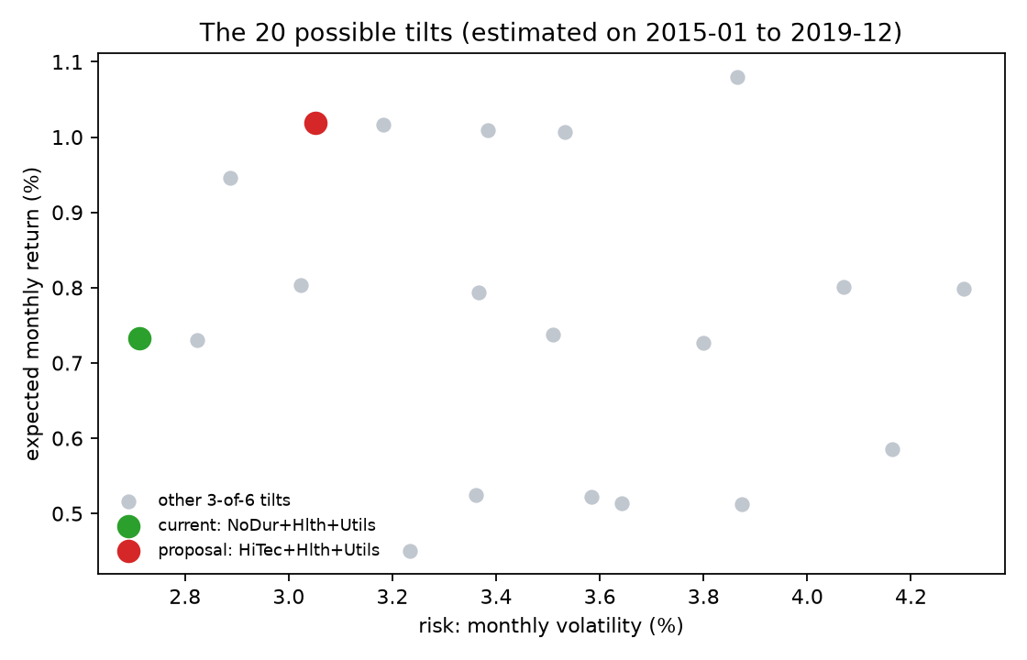
THE 20 OPTIONS
Six switches, twenty legal settings
Each industry is a switch (on = held). 64 settings, only 20 with exactly three on. A normal computer checks all 20 instantly: our answer key.
2015–19 monthly | Current | Proposal
Average return | 0.73 % | 1.02 %
Volatility | 2.71 % | 3.05 %
Worst month | −8.11 % | −7.08 %
Loss above 3 % | 8.3 % | 10.0 %
Risk measures disagree. Which one counts is a choice, not a fact.
Source: supplied data 2015–19, canonical run (fig_risk_return)
Notes:
Six switches, 64 settings, only 20 with exactly three holdings. That is why enumeration is trivial and why we never say quantum is needed here. The chart shows the tension: return versus swings, and the table shows risk measures that disagree. For the risk-sensitive profile only 7 of the 20 pass the loss rule.

Slide 9
HOW IT WORKS
One qubit per sector, rules built into the circuit
NoDur
Manuf
Enrgy
HiTec
Hlth
Utils
One qubit per sector. Light = held. This is today’s holding.
STEP 1 · START
STEP 2 · COST
STEP 3 · MIX
REPEAT · LEARN
Spread evenly over all legal portfolios
Tilt: cheap portfolios become more likely
Stir: let the cloud move to neighbours
A normal computer tunes two knobs, tries again, then we measure
This is QAOA. We run it on a laptop simulator, many times with different seeds.
Quantum is one component. The loss rule and the verdict stay classical.
Notes:
Plain analogy: a cloud sitting on all legal portfolios at once. Step 2 tilts the cloud toward cheap portfolios, step 3 stirs it so it can reach neighbouring portfolios. A classical optimiser adjusts how hard to tilt and stir. At the end we measure many times; the most frequent answer is the suggestion. QAOA is a heuristic; it does not guarantee the best answer.

Slide 10
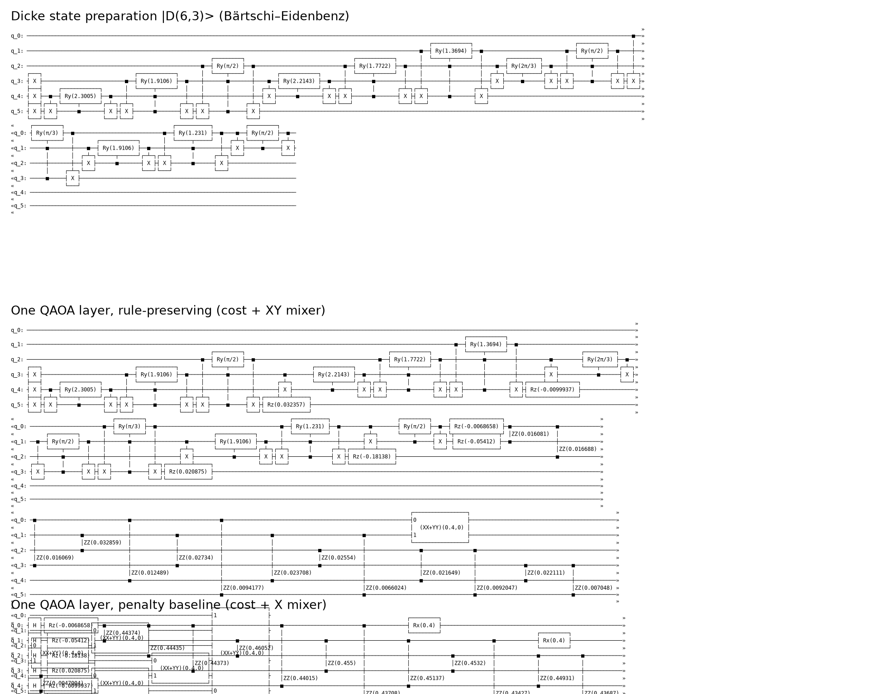
QUANTUM VS QUANTUM
Fence around the road, or no road at all
 | Organiser’s penalty QAOA | Our rule-preserving QAOA
Start | All 64 settings | Only the 20 legal ones
Stirring | Flips single switches | Swaps on and off, count stays 3
3 holdings | Big punishment in the cost | Cannot be broken
Illegal samples | Yes, 2–68 % | None
Penalty: a fence around a field, and the sheep still wander into the road.
Ours: a field where the road does not exist.
Quantum against quantum. Our circuit is deeper but never leaves the legal set. Exact enumeration is only the answer key.
Notes:
The organiser notebook adds penalties; we move the rule into the circuit. Reference: Hadfield et al. 2019. Our circuit is deeper (depth about 392 at three layers versus 81), a real cost. The loss rule stays an exact check after sampling because it is not cheaply encodable.

Slide 11
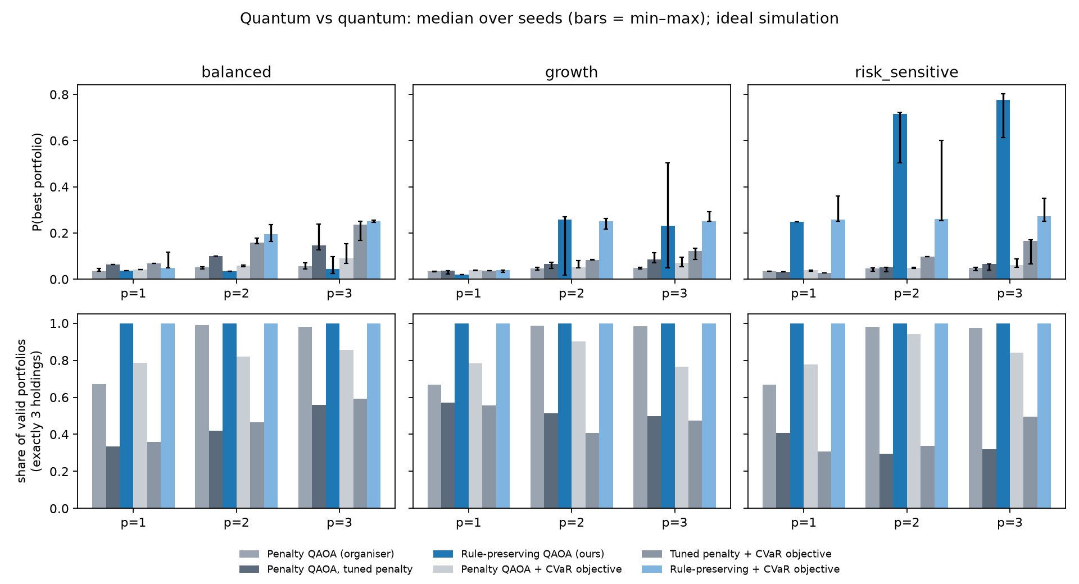
RESULTS · CANONICAL RUN
Chance of sampling the exact best portfolio
Six variants: organiser’s penalty QAOA, tuned penalty, our rule-preserving QAOA, each also with a CVaR objective. Median of 10 seeds, 3 layers. Guessing: 0.05.
Risk-sensitive: ours 0.77 vs 0.05 (organiser), 0.07 (tuned)
Growth: ours 0.23 (CVaR 0.25) vs 0.05, 0.09
Balanced: near-tie. Ours 0.04, with CVaR 0.25
Valid portfolios: 100 % ours, 32–98 % penalty versions
Ideal simulation. Seeds vary a lot (min–max bars). Exact enumeration is the answer key. No quantum advantage.
Notes:
Quantum against quantum, ideal simulation, 10 seeds. Our design wins clearly for risk-sensitive and is better for growth. Balanced is a near-tie: the mean objective fails (0.04), the CVaR objective helps (0.25; the right answer is decoded in 90 percent of runs). Be honest: the tuned penalty also does well at the tie (0.15), but only about half of its samples are valid portfolios. Mean-cost optimisation does not maximise the probability of the best portfolio, and results vary between seeds.

Slide 12
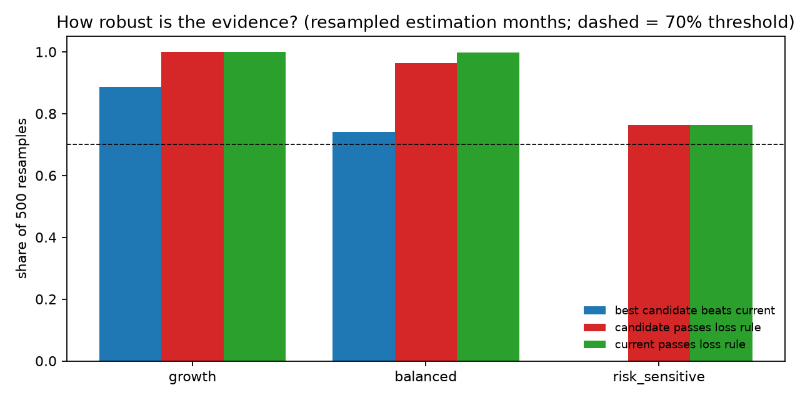
RESULTS · CANONICAL RUN
One proposal, three different answers
Profile | Verdict | Portfolio | Evidence
Growth | Switch | HiTec + Hlth + Utils | Same winner in 3 scenarios; beats current in 89 % of resamples
Balanced | Review | Hold; committee decides | Return stress flips it; beats current in 74 %
Risk-sensitive | Keep | NoDur + Hlth + Utils | Winner in 3 scenarios; passes loss rule in 76 %
Switch needs the same winner everywhere and at least 70 % of 500 resamples in favour. Keep needs the current tilt best and admissible in 70 %.
Balanced is the assumed default, so the fragile answer lands on people who did not choose.
Canonical run. Bootstrap = resampling the 60 months (fig_bootstrap). Tech limit is a preference; same verdicts without it.
Notes:
Verdict rule tightened after code review: burden of proof on the change. Growth switches. Balanced is review because the optimum flips under the supplied return stress and the proposal beats current in only 74 percent of resamples; default action is to hold. Risk-sensitive keeps; it passes the loss rule in 76 percent of resamples and in 12.6 percent no portfolio passes. With the tech limit penalty at zero the verdicts are identical.

Slide 13
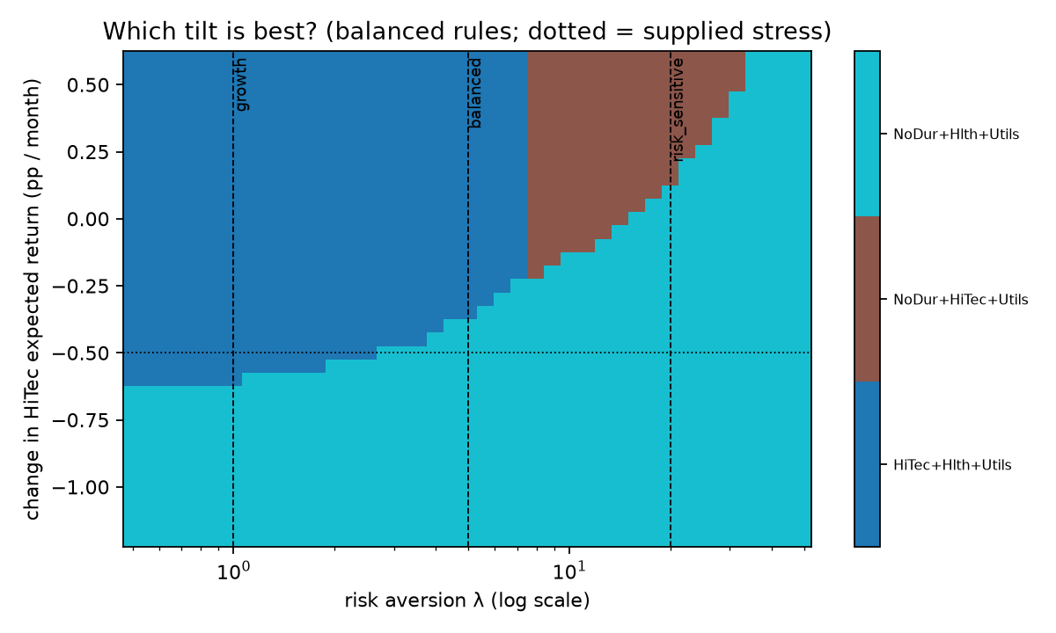
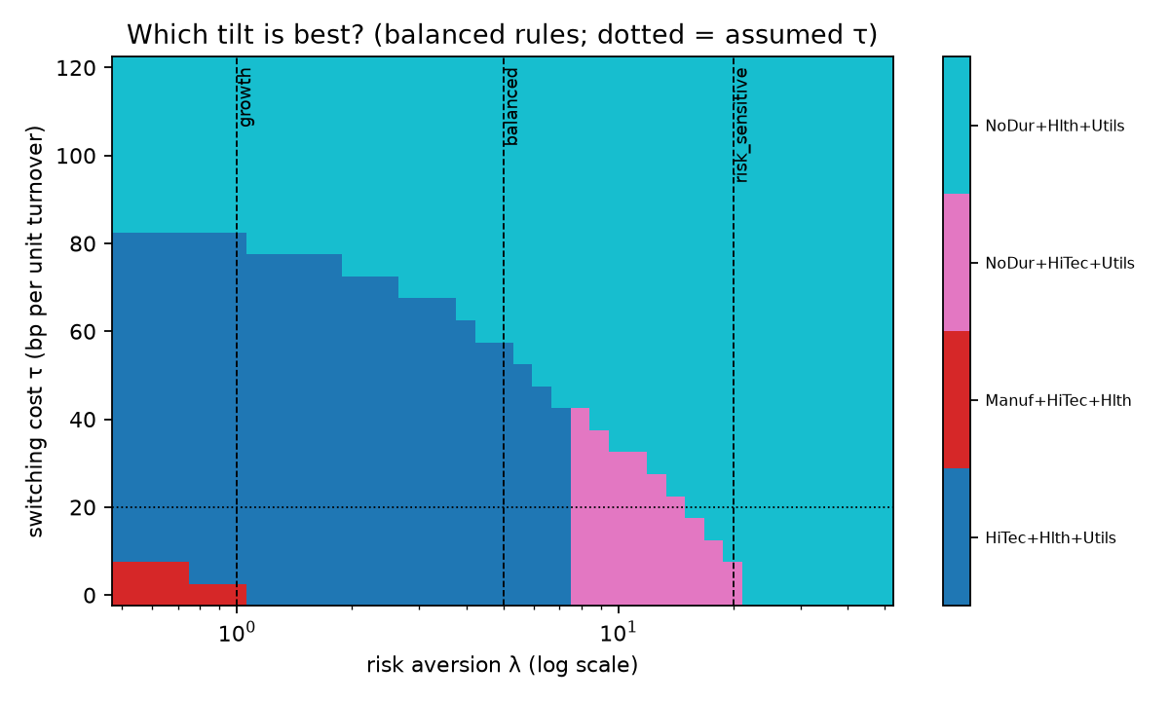
WHAT WOULD CHANGE THE ANSWER
Balanced sits right on the edge
Tech edge −0.37 pts
Switching cost 0.0057
Risk weight 7.5 / 14.9
per month (supplied stress: −0.50)
about 3× the base 0.002
to NoDur+HiTec+Utils / to current (base 5)
Score margin is only 0.0012 per month. Switch only if you believe tech’s edge stays above about 0.37 points.
Notes:
Break-even: the value of an assumption at which the best choice flips. Balanced has three, all close. The pairwise proposal-versus-current break-even is not the whole picture: with risk weight the proposal first gives way to NoDur+HiTec+Utils at 7.5, then to current at 14.9. The risk-sensitive profile uses a risk weight of 20, so it keeps. The tech limit is a preference with penalty 0.01; verdicts are identical without it.

Slide 14
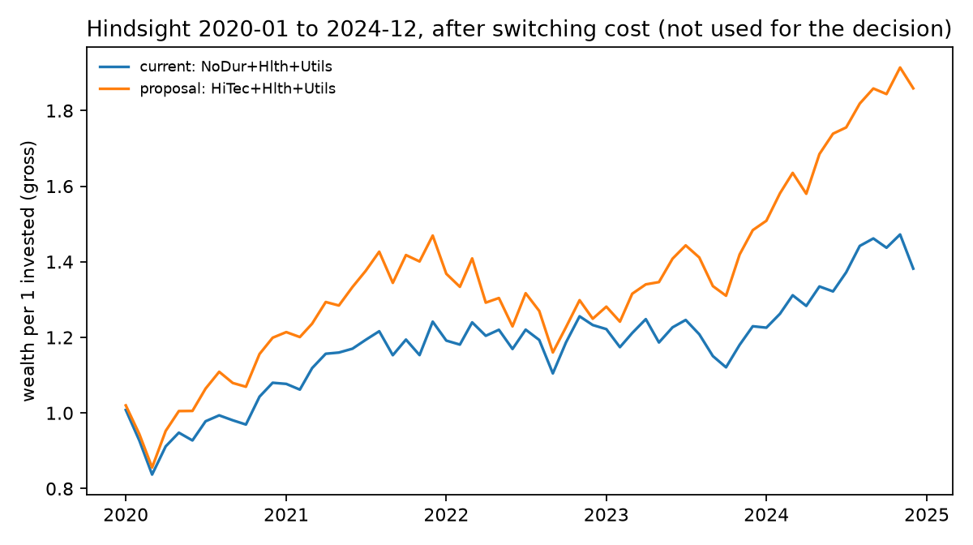
HINDSIGHT, 2020–2024
Tech won, and losses came more often
Wealth (incl. switch cost): 1.86 proposal vs 1.38 current
Drawdown: −21 % vs −17 %
Months above each profile’s loss threshold: growth 5 % vs 3 %, balanced 13 % vs 8 %, risk-sensitive 20 % both
Rebalancing at 2 % or 5 % drift did not beat holding the proposal.
Evaluation only, never a decision input. One path does not prove the 2019 decision right or wrong.
Notes:
Hold-out check using the canonical holdout values, including the one-off switching cost. The proposal grew more with a deeper drawdown. Loss frequencies are higher than the 2015-19 scenario model implied, so the loss rule understates tail risk. We use the period to test decision rules and our risk model, not to pick winners after the fact.

Slide 15
RESPONSIBILITY
Is the difference in the world, or in our computer?
Estimation uncertainty
Computational variation
Only 60 months. Measured by resampling the months at least 500 times.
Random seeds, shots, depth. Measured by repeating the quantum run.
Decides Review vs Switch.
Never decides: the exact optimum is always computed.
Active choice: the insured each pick a profile, so it must be explained in plain words.
Default effect: non-choosers get balanced, the most fragile answer. A default needs a justification.
Outside the model: tilt size, the core, liquidity, tax, global universe, politics.
Supervision and DORA applicability are our reading and still to be confirmed. Details: docs/responsibility.md
Notes:
The responsibility issue built into the model: keep estimation uncertainty and computational variation apart, so a committee knows what it is looking at. Before a real institution relies on it: written committee beliefs, independent validation, longer and global data, tail-risk model, fairness check for defaults, local compute only (DORA/sovereignty). KENFO is the template; supervision of the new fund is not fixed by law yet.

Slide 16
LIMITS
No quantum advantage, and we say so
What we do show
What we do not show
A checked encoding that keeps the rules
Every result graded against the exact answer
A map of what flips the answer
Same numbers on a second laptop
That quantum beats classical: 20 options are trivial
Hardware results: simulator only, no noise
Real-fund fit: 60 months, US sectors, no liquidity, tax or ESG
Real mandate numbers: ours are assumptions
Equal weights and exactly 3 holdings are simplifications. The switching cost is a proxy, not a fee model.
A small, transparent result beats a big unexplained one.
Notes:
Say these before the jury does. The value is correct, rule-preserving encoding and verification, and a path to larger problems where enumeration is no longer possible. Even there, advantage is not established.

Slide 17
MAJOR MILESTONES
Done in the sprint, next until 30 October
DONE
Numbers
Stress
✓ Model frozen in one config
✓ Answer key + tests
✓ QAOA runs, p = 1–3, 10 seeds
✓ Bootstrap, break-even, hindsight
✓ Draft Decision Card
More seeds, shot-noise runs, final reruns
Ledoit–Wolf, shrunk means, energy exclusion, the mid-hackathon change
Policy
Final pitch · 30 Oct
Confirm supervision and our DORA reading
Decision Card, findings note, everyone can explain their part
Full canonical run: about 21 minutes on a laptop, one command: python scripts/run_all.py run --canonical
Notes:
The full pipeline runs in about 21 minutes on a laptop; anyone can reproduce it with one command. Each step logs where we deviate from the organiser notebook, the AI baseline.

Slide 18
FALLBACKS
If something does not happen
IF | THEN
Quantum results jump between seeds | Report median and min–max; the exact optimum always decides
Shot noise erases our edge | Say so openly; show validity, which needs no luck: 100 % vs 32–98 %
The balanced near-tie stays unresolved | “Review” is a valid verdict: show the break-even instead
Advisers can’t confirm DORA in time | Present it as our reading; keep compute local, no foreign cloud
The organisers change the task mid-hackathon | Change one setting, rerun, and diff: we see which verdict flipped
The exact answer for all 20 portfolios always exists, so a correct decision can be shown whatever fails
Notes:
The problem is small enough that the exact answer always exists – whatever fails, we can still show a correct decision. Commands: run --set changes one assumption, diff compares two runs.

Slide 19
WHAT WE NEED FROM YOU
Appointments, resources, help
GTPP advisers
Quantum mentor
Still open in our team
Does DORA apply? Which responsibility issue do we build into the model?
Review of our Dicke-state and XY-mixer circuit
Default profile for non-choosers, and who presents which part on 30 October
The one condition on the Decision Card: do not follow the switch if tech’s edge came from a rally you do not expect to continue.
Thank you. Questions?
Code and docs: GitHub repository, README · Sprint presentation · Project Plan · 16 October 2026
Notes:
Proposed default for people who don’t choose: balanced – but that is the most fragile answer, so the default needs a justification. Close with the one condition from the Decision Card: do not follow the switch if tech’s edge came from a rally you do not expect to continue.

